Slide 1
MTC : strategie

Slide 2
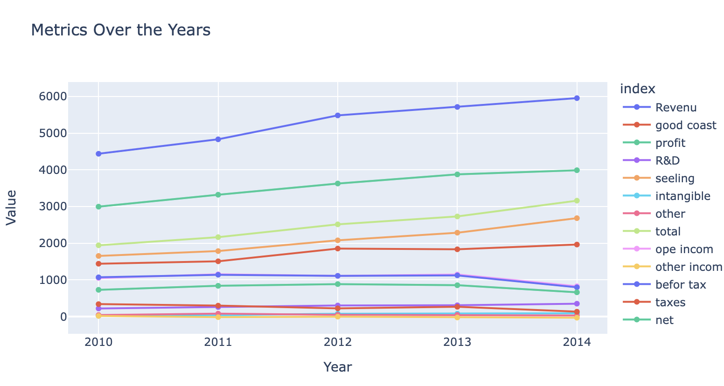
New Tax : lost of profile

Slide 3
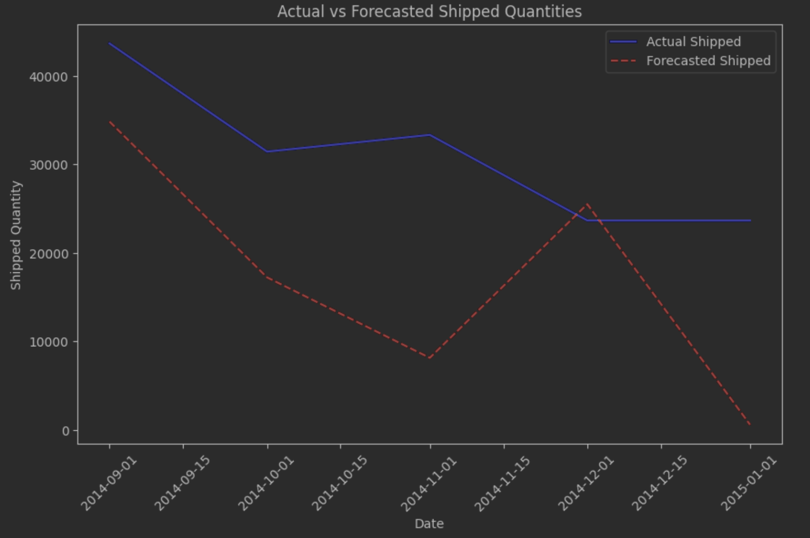
Forecasting Strategie

Slide 4
Option
Implement the price of the product
Negotiate better prices from the supplier
Implement onside product sterilizing to decrease the coast

Slide 5
Onside sterilising
Object decrease price:
Need heavy investment for set up the solution
Run costs hight with a risk to stop if not compliance with safety regulation
Need to implemt business intelligence for follow stock

Slide 6
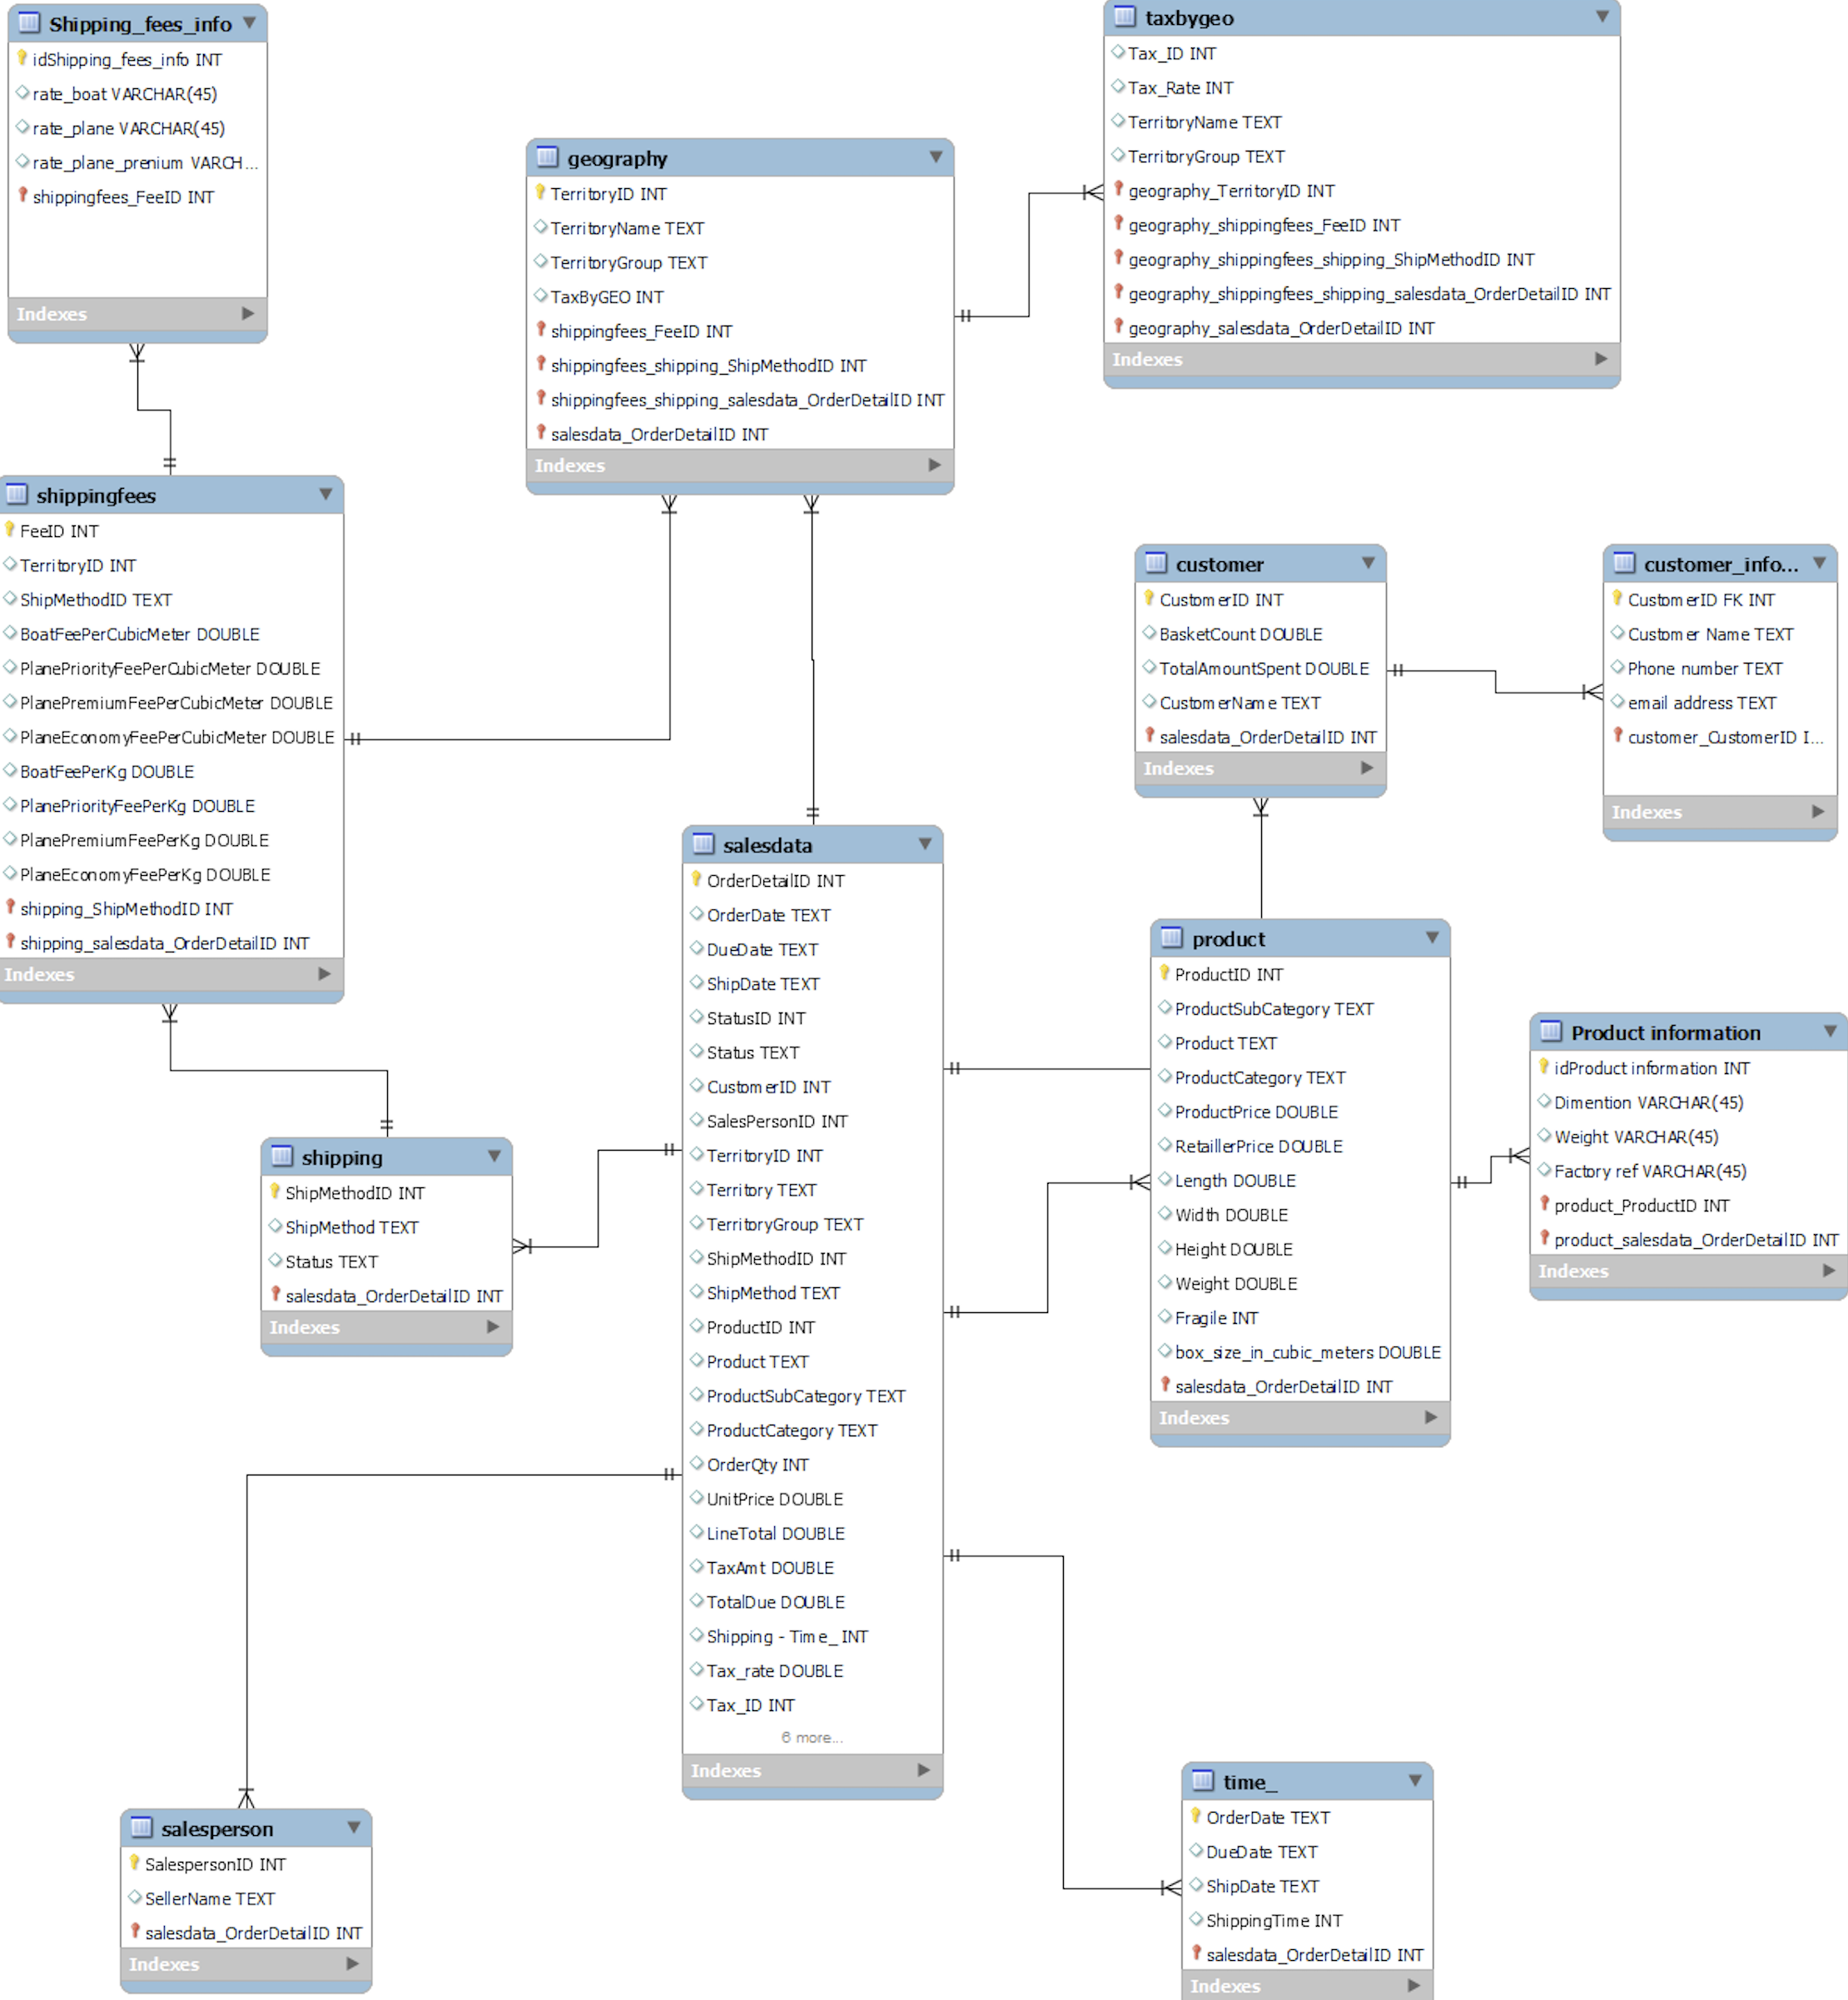
Propose Database schema for follow stock

